Slide 1
Radial Basis Function Networks (PART 2)

Slide 2
Chapter Organization
Construction of an RBF network
Part 2
Supervised learning as an hypersurface reconstruction problem
Tikhonov’s regularization theory
Regularization networks
Generalized RBF networks
Solving XOP problem with an RBF network
Regularization parameter
Part 3
Approximation properties of RBF networks
Comparison of RBF networks and multilayer perceptrons
Part 4 (omitted)
Kernel regression estimation (omitted)
Part 5
Learning strategies for RBF networks
Example computer experiment

Slide 3
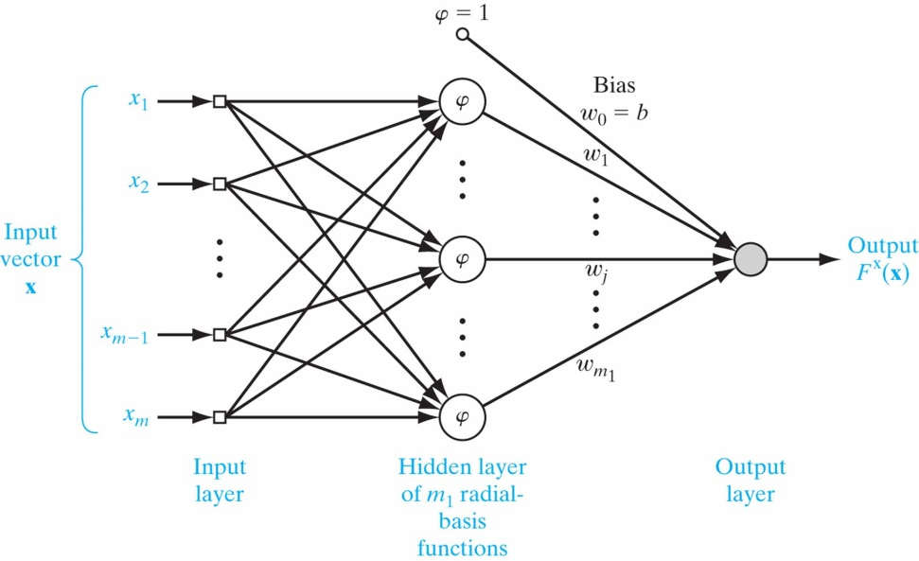
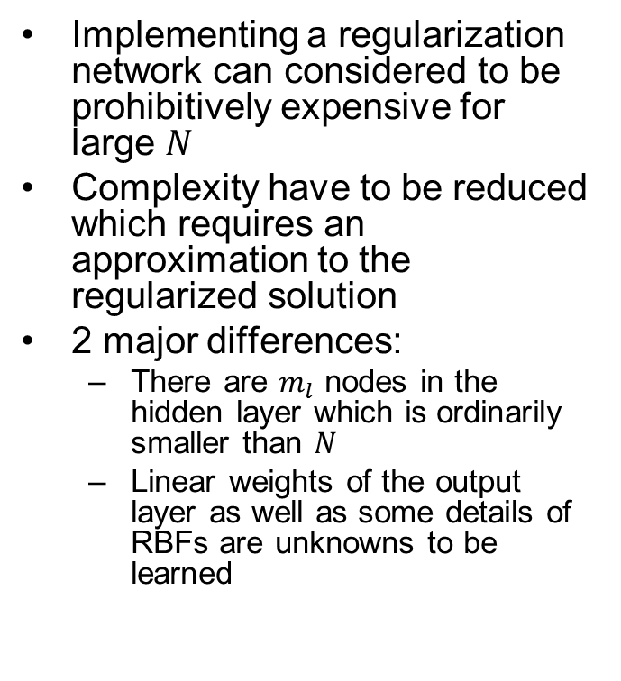
Generalized RBF Networks
Implementing a regularization network can considered to be prohibitively expensive for large $N$
Complexity have to be reduced which requires an approximation to the regularized solution
2 major differences:
There are $m_{l}$ nodes in the hidden layer which is ordinarily smaller than $N$
Linear weights of the output layer as well as some details of RBFs are unknowns to be learned

Slide 4
Chapter Organization
Construction of an RBF network
Part 2
Supervised learning as an hypersurface reconstruction problem
Tikhonov’s regularization theory
Regularization networks
Generalized RBF networks
Solving XOP problem with an RBF network
Regularization parameter
Part 3
Approximation properties of RBF networks
Comparison of RBF networks and multilayer perceptrons
Part 4 (omitted)
Kernel regression estimation (omitted)
Part 5
Learning strategies for RBF networks
Example computer experiment

Slide 5
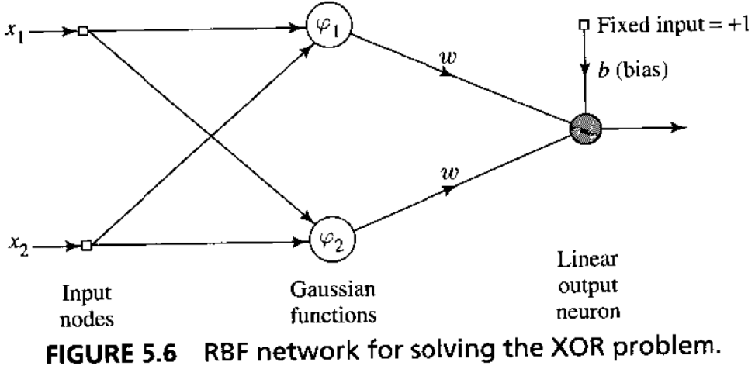
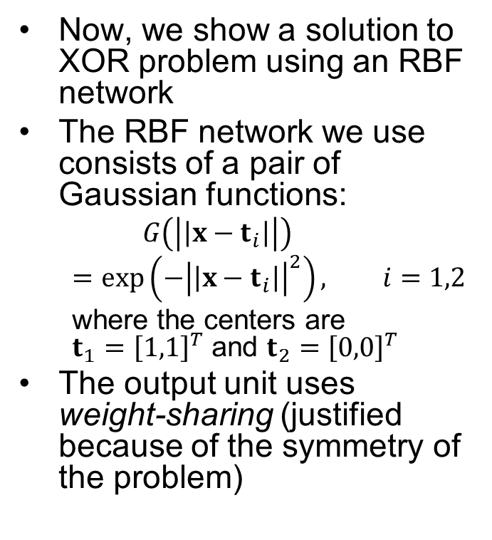
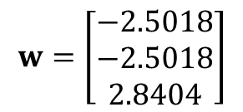
XOR Problem (Revisited)
Now, we show a solution to XOR problem using an RBF network
The RBF network we use consists of a pair of Gaussian functions:
$$G\left(\left|\left|x−t_{i}\right|\right|\right)=\exp\left(−{\left|\left|x−t_{i}\right|\right|}^{2}\right), i=1,2$$
where the centers are $t_{1}={\left[1,1\right]}^{T}$ and $t_{2}={\left[0,0\right]}^{T}$
The output unit uses weight-sharing (justified because of the symmetry of the problem)
$$w=\left[\begin{matrix}−2.5018 \\ −2.5018 \\ 2.8404\end{matrix}\right]$$

Slide 6
Chapter Organization
Construction of an RBF network
Part 2
Supervised learning as an hypersurface reconstruction problem
Tikhonov’s regularization theory
Regularization networks
Generalized RBF networks
Solving XOP problem with an RBF network
Regularization parameter
Part 3
Approximation properties of RBF networks
Comparison of RBF networks and multilayer perceptrons
Part 4 (omitted)
Kernel regression estimation (omitted)
Part 5
Learning strategies for RBF networks
Example computer experiment

Slide 7
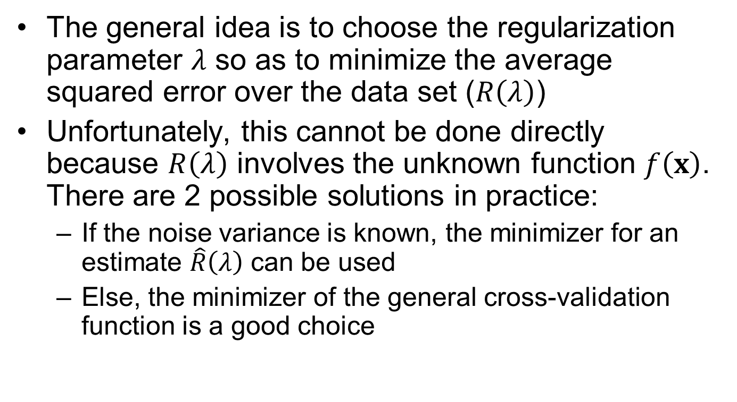
Estimation of the Regularization Parameter
The general idea is to choose the regularization parameter $λ$ so as to minimize the average squared error over the data set ($R\left(λ\right)$)
Unfortunately, this cannot be done directly because $R\left(λ\right)$ involves the unknown function $f\left(x\right)$. There are 2 possible solutions in practice:
If the noise variance is known, the minimizer for an estimate $\hat{R}\left(λ\right)$ can be used
Else, the minimizer of the general cross-validation function is a good choice

Slide 8
Chapter Organization
Construction of an RBF network
Part 2
Supervised learning as an hypersurface reconstruction problem
Tikhonov’s regularization theory
Regularization networks
Generalized RBF networks
Solving XOP problem with an RBF network
Regularization parameter
Part 3
Approximation properties of RBF networks
Comparison of RBF networks and multilayer perceptrons
Part 4 (omitted)
Kernel regression estimation (omitted)
Part 5
Learning strategies for RBF networks
Example computer experiment

Slide 9
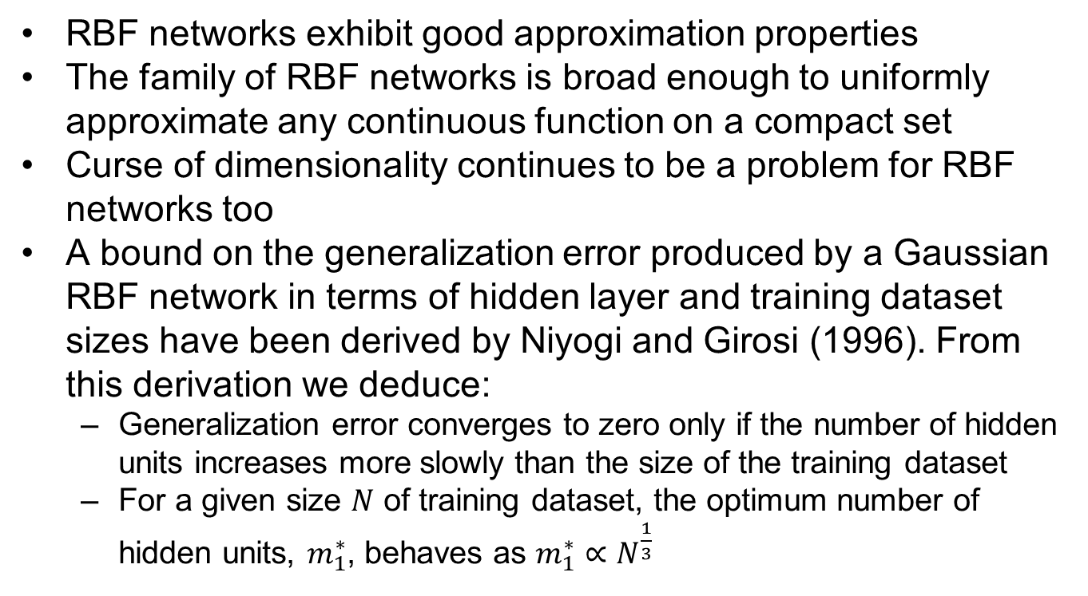
Approximation Properties of RBF Networks
RBF networks exhibit good approximation properties
The family of RBF networks is broad enough to uniformly approximate any continuous function on a compact set
Curse of dimensionality continues to be a problem for RBF networks too
A bound on the generalization error produced by a Gaussian RBF network in terms of hidden layer and training dataset sizes have been derived by Niyogi and Girosi (1996). From this derivation we deduce:
Generalization error converges to zero only if the number of hidden units increases more slowly than the size of the training dataset
For a given size $N$ of training dataset, the optimum number of hidden units, $m_{1}^{∗}$, behaves as $m_{1}^{∗}∝N^{\frac{1}{3}}$

Slide 10
Chapter Organization
Construction of an RBF network
Part 2
Supervised learning as an hypersurface reconstruction problem
Tikhonov’s regularization theory
Regularization networks
Generalized RBF networks
Solving XOP problem with an RBF network
Regularization parameter
Part 3
Approximation properties of RBF networks
Comparison of RBF networks and multilayer perceptrons
Part 4 (omitted)
Kernel regression estimation (omitted)
Part 5
Learning strategies for RBF networks
Example computer experiment

Slide 11
Comparison of RBF Networks and MLPs
Both are examples of nonlinear layered feedforward networks
Both are universal approximators
There always exists an RBF network that can mimic a given MLP, or vice versa. But, these networks are different in several important respects:
An RBF network has a single hidden layer, whereas an MLP may have one or more
Typically, computation nodes of an MLP share a common neural model. But in an RBF network they are different and serve different purposes
In an RBF network, hidden layer is nonlinear and output layer is linear. But in an MLP used for classification, usually all units are nonlinear. When the MLP is used for solving nonlinear regression problems, a linear output layer is preferred.
Argument of the activation functions in an RBF network computes distance between input and a center. But activation functions in an MLP compute an inner product
MLPs construct global approximations but RBF networks (with certain specific choices) construct local approximations

Slide 12
Chapter Organization
Construction of an RBF network
Part 2
Supervised learning as an hypersurface reconstruction problem
Tikhonov’s regularization theory
Regularization networks
Generalized RBF networks
Solving XOP problem with an RBF network
Regularization parameter
Part 3
Approximation properties of RBF networks
Comparison of RBF networks and multilayer perceptrons
Part 4 (omitted)
Kernel regression estimation (omitted)
Part 5
Learning strategies for RBF networks
Example computer experiment

Slide 13
Learning Strategies
The linear weights of the output unit tend to evolve on a different “time-scale” compared to nonlinear activation functions of the hidden units
It is reasonable to separate the optimization of hidden and output layers
There are different learning strategies that can be used in designing an RBF network depending on how the centers of the RBFs are specified
Fixed centers selected at random
Self-organized selection of centers
Supervised selection of centers
Strict interpolation with regularization

Slide 14
Learning Strategies
Fixed centers selected at random
simplest.
Assume fixed RBFs defining the activation functions of the hidden units.
Locations of centers can be chosen randomly from the training dataset.
For RBFs, we may employ an isotrophic Gaussian function whose standard deviation is fixed w.r.t. spread of centers
Self-Organized selection of centers
Problem with the previous one is that it may require a large training set for satisfactory performance
A hybrid learning process with 2 stages may be used to overcome this
Self-organized learning stage in which the purpose is to estimate appropriate center locations for RBFs in the hidden layer
Supervised learning stage which completes the design by estimating the linear weights of the output layer
Batch processing can be used but an adaptive (iterative) approach is preferred
A clustering algorithm such as k-means clustering is used for the self-organized learning process

Slide 15
Learning Strategies
Supervised selection of centers
Centers and all other free parameters undergo a supervised learning process
A natural choice is to use error-correction learning which uses a gradient descent procedure
Strict interpolation with regularization
Combines elements of regularization theory and kernel regression estimation theory in a principled way

Slide 16
Chapter Organization
Construction of an RBF network
Part 2
Supervised learning as an hypersurface reconstruction problem
Tikhonov’s regularization theory
Regularization networks
Generalized RBF networks
Solving XOP problem with an RBF network
Regularization parameter
Part 3
Approximation properties of RBF networks
Comparison of RBF networks and multilayer perceptrons
Part 4 (omitted)
Kernel regression estimation (omitted)
Part 5
Learning strategies for RBF networks
Example computer experiment

Slide 17
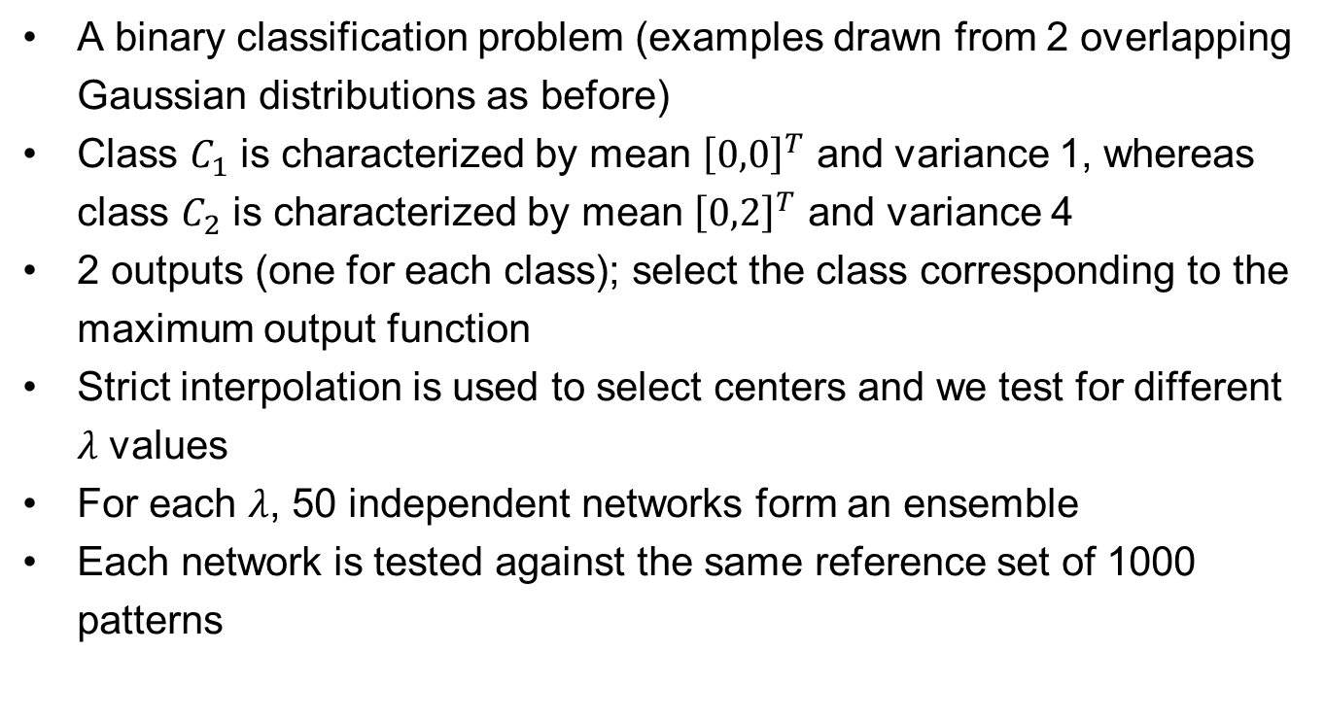
Computer Experiment: Pattern Classification
A binary classification problem (examples drawn from 2 overlapping Gaussian distributions as before)
Class $C_{1}$ is characterized by mean ${\left[0,0\right]}^{T}$ and variance 1, whereas class $C_{2}$ is characterized by mean ${\left[0,2\right]}^{T}$ and variance 4
2 outputs (one for each class); select the class corresponding to the maximum output function
Strict interpolation is used to select centers and we test for different $λ$ values
For each $λ$, 50 independent networks form an ensemble
Each network is tested against the same reference set of 1000 patterns

Slide 18
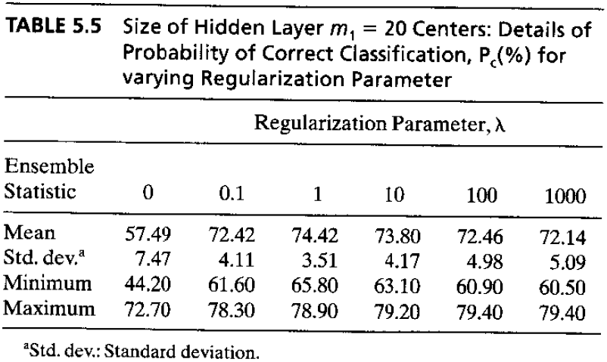
Computer Experiment: Pattern Classification

Slide 19
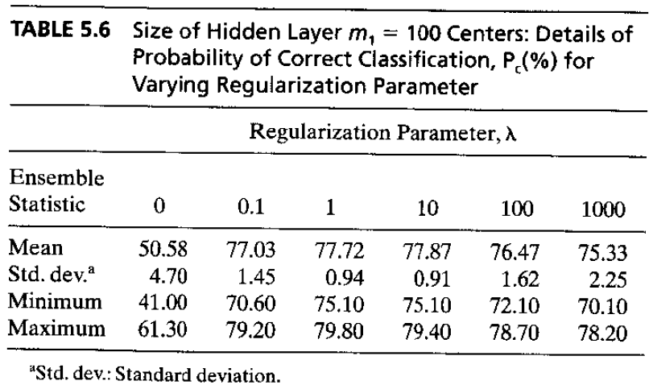
Computer Experiment: Pattern Classification

Slide 20
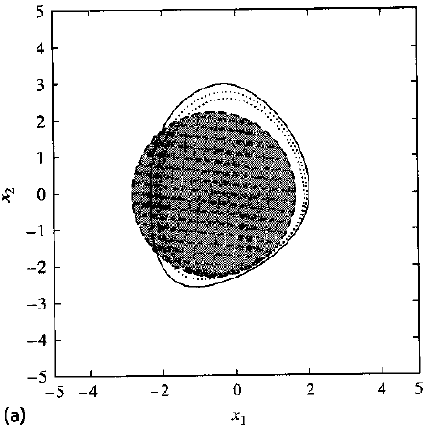
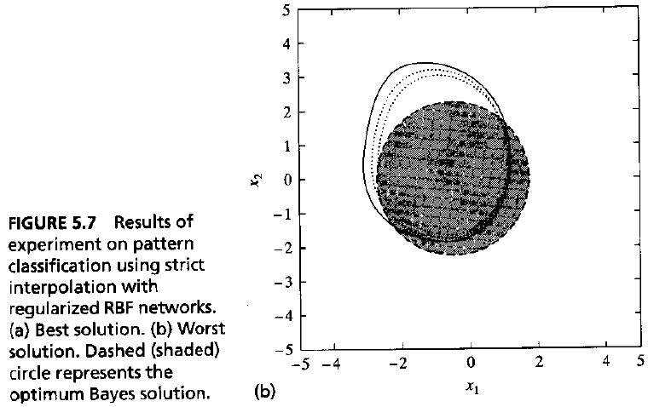
Computer Experiment: Pattern Classification

Slide 21
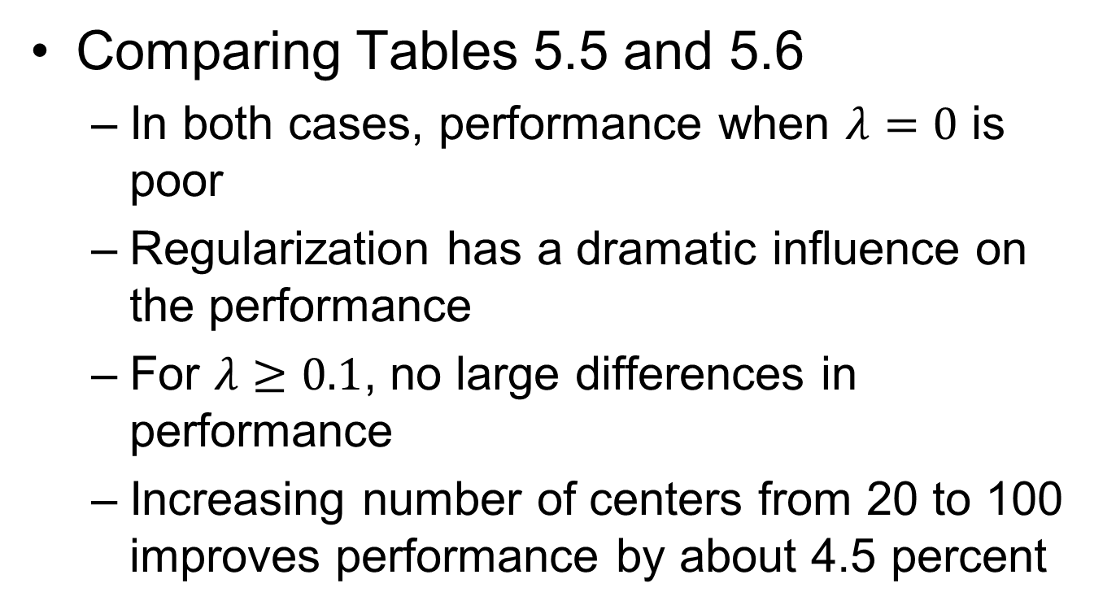
Computer Experiment: Pattern Classification
Comparing Tables 5.5 and 5.6
In both cases, performance when $λ=0$ is poor
Regularization has a dramatic influence on the performance
For $λ≥0.1$, no large differences in performance
Increasing number of centers from 20 to 100 improves performance by about 4.5 percent

